Slide 1
Actuator monitoring in a jet-driven UAV: Results and Lessons

Slide 2
System layout
Flight segments
Take aways

Slide 3
System layout
Flight segments
Take aways

Slide 4
Notes:
Jeti system with 3 receivers, Px4 as autopilot, Jet-Cat 120p turbine.

Slide 6
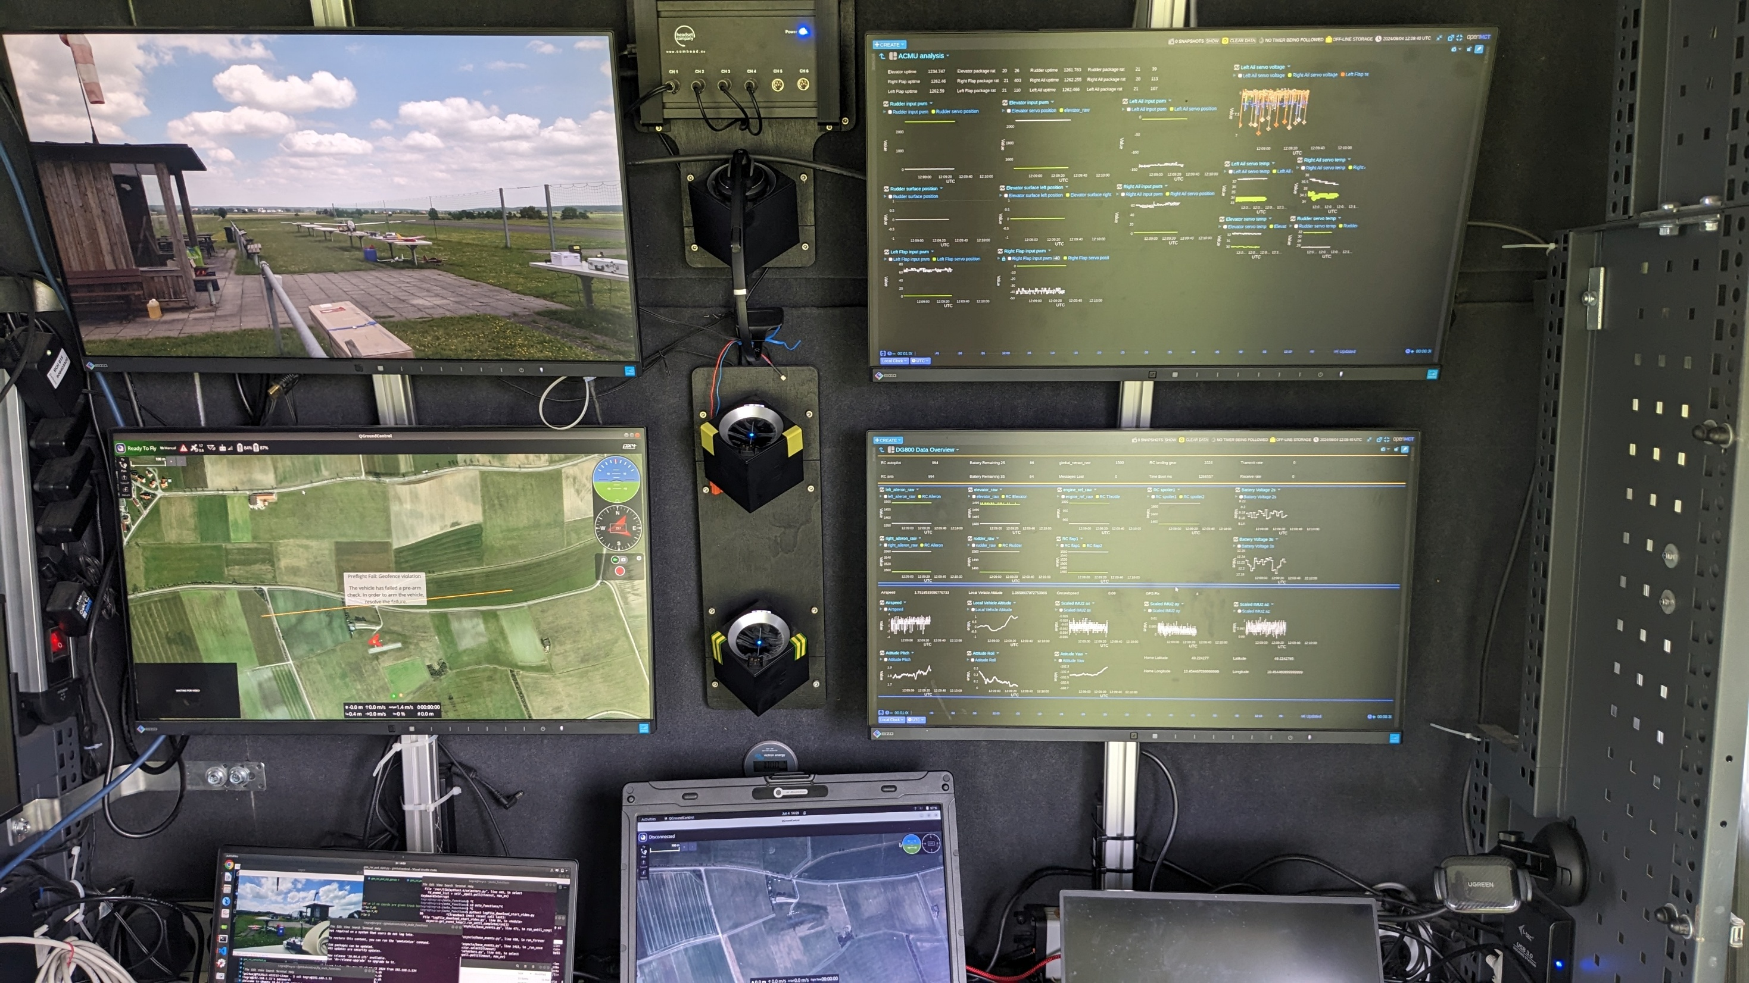

Slide 7
1
3
2
4
5
6
7
6

Slide 8
System layout
Flight segments
Take aways

Slide 9
Flight segments
Takeoff
Inverted Freq. sweep
360 roll
landing

Slide 10
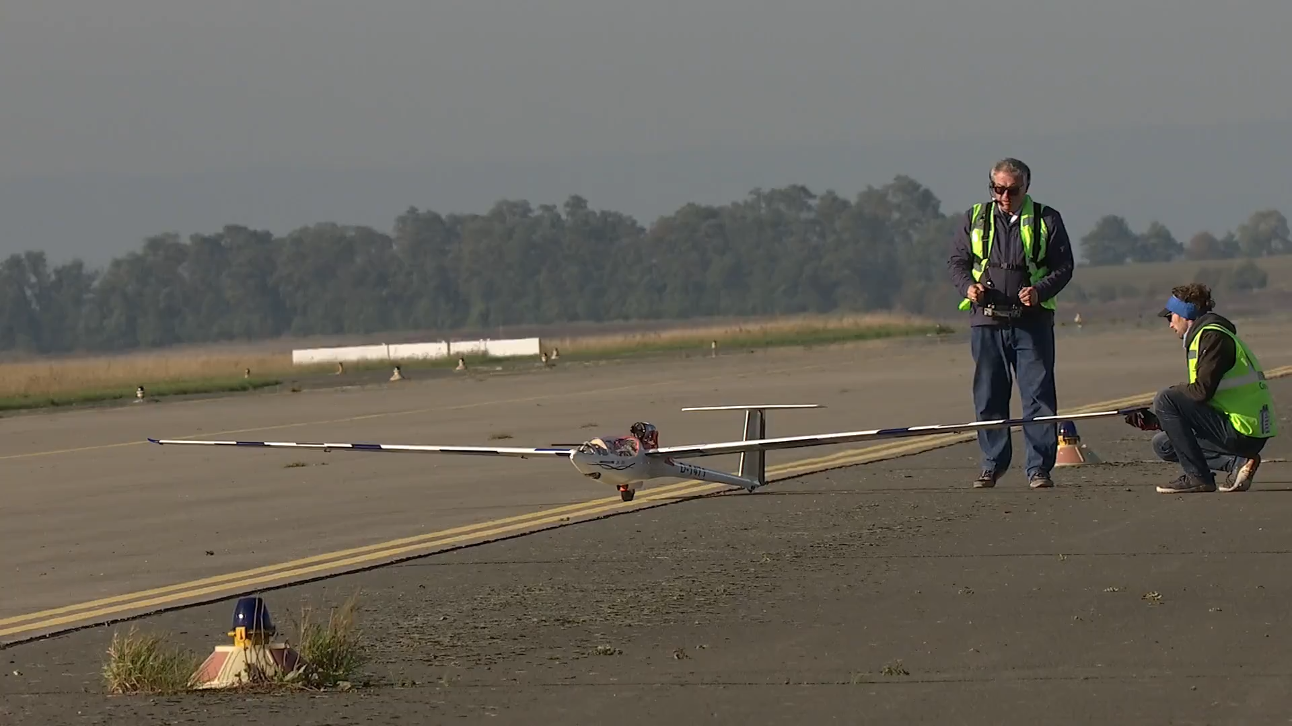

Slide 11
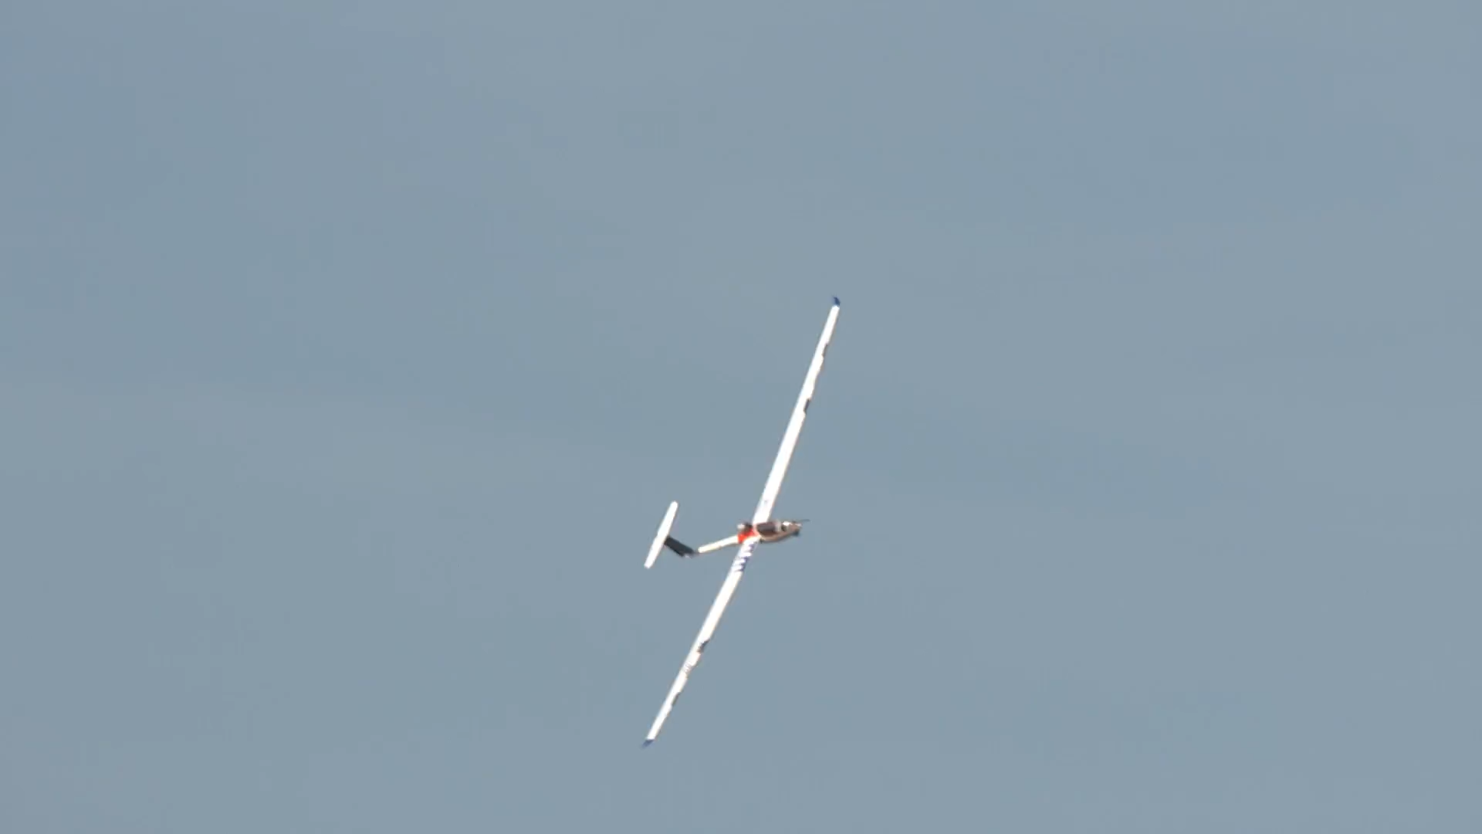

Slide 12
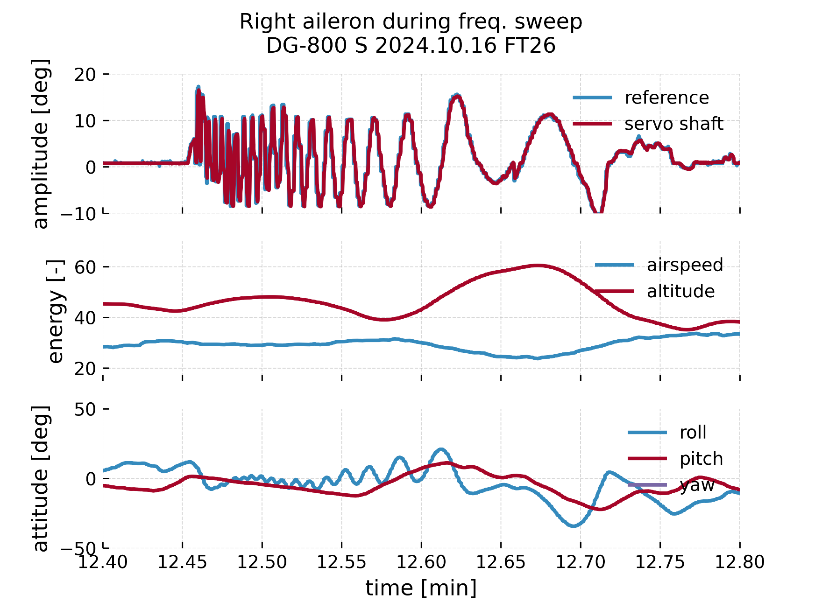

Slide 13
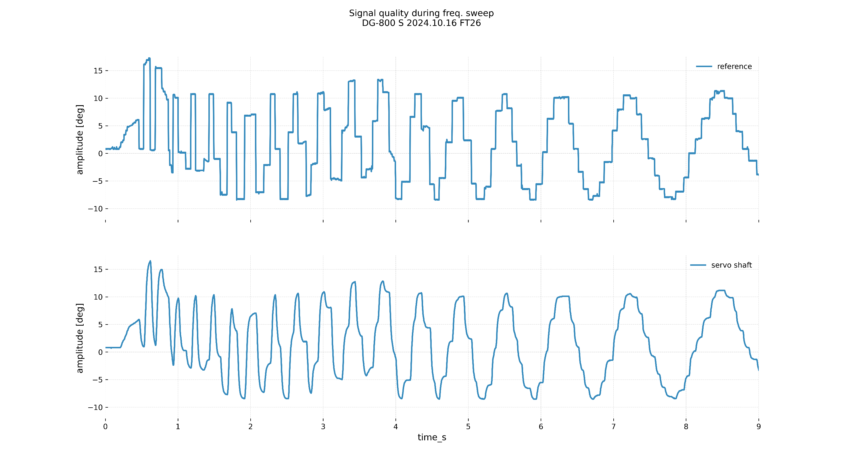
Notes:
Bad signal quality from the generator. The used DS-24 model was overloaded with custom lua tools, making the lua part slow, thus the generated signal are pretty low quality.

Slide 14
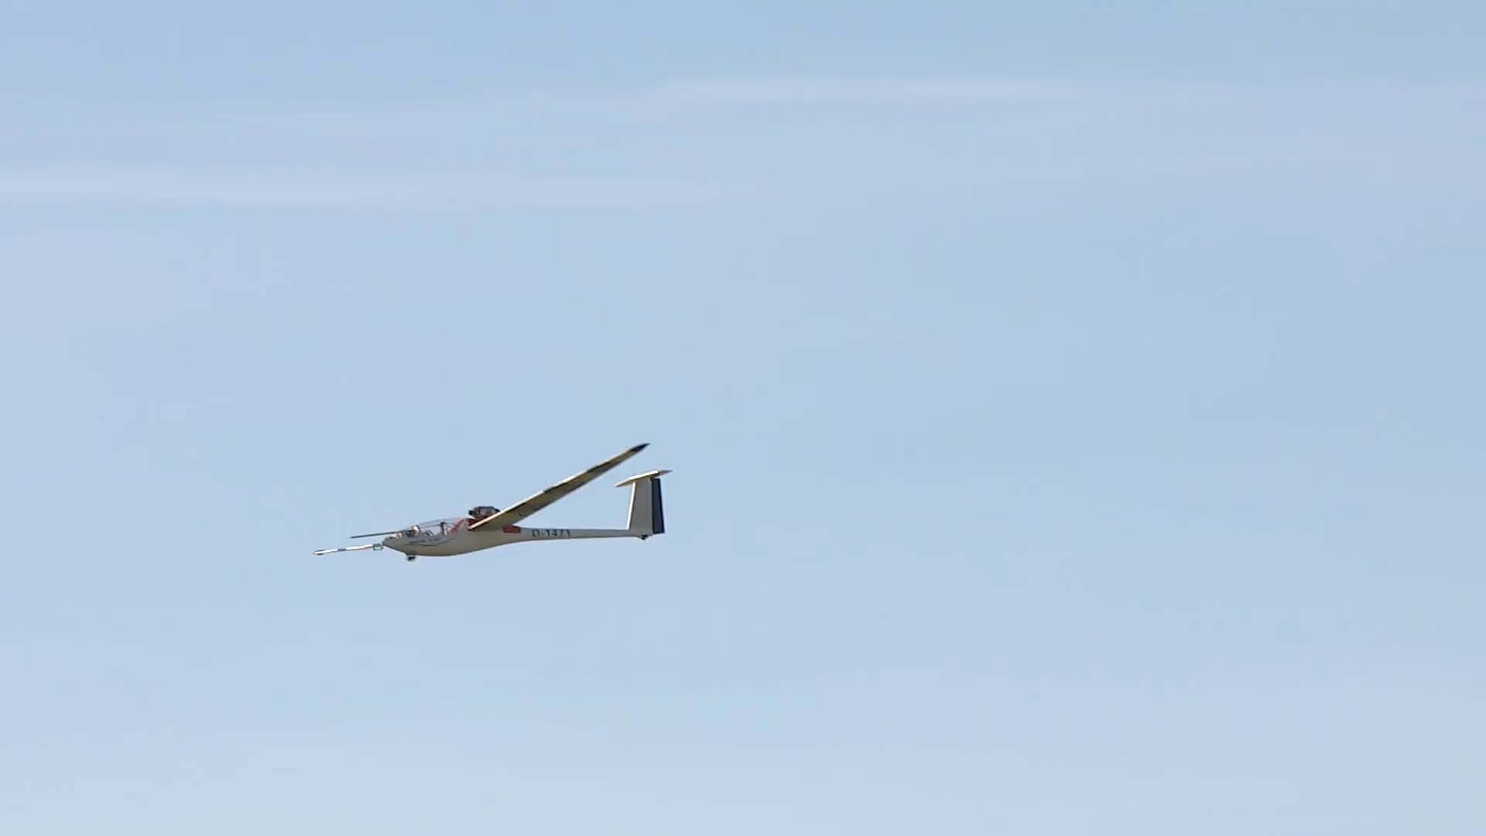

Slide 15
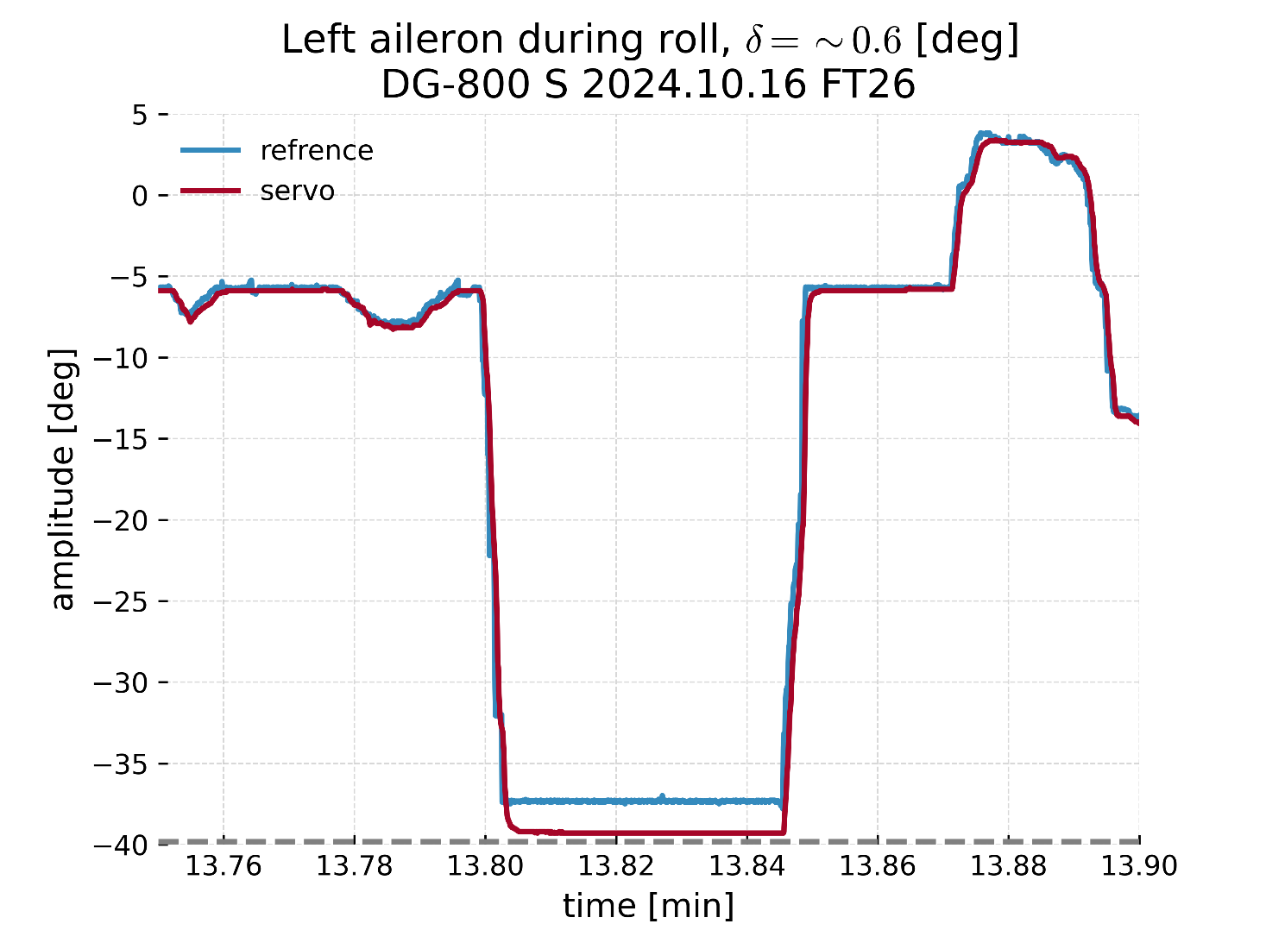
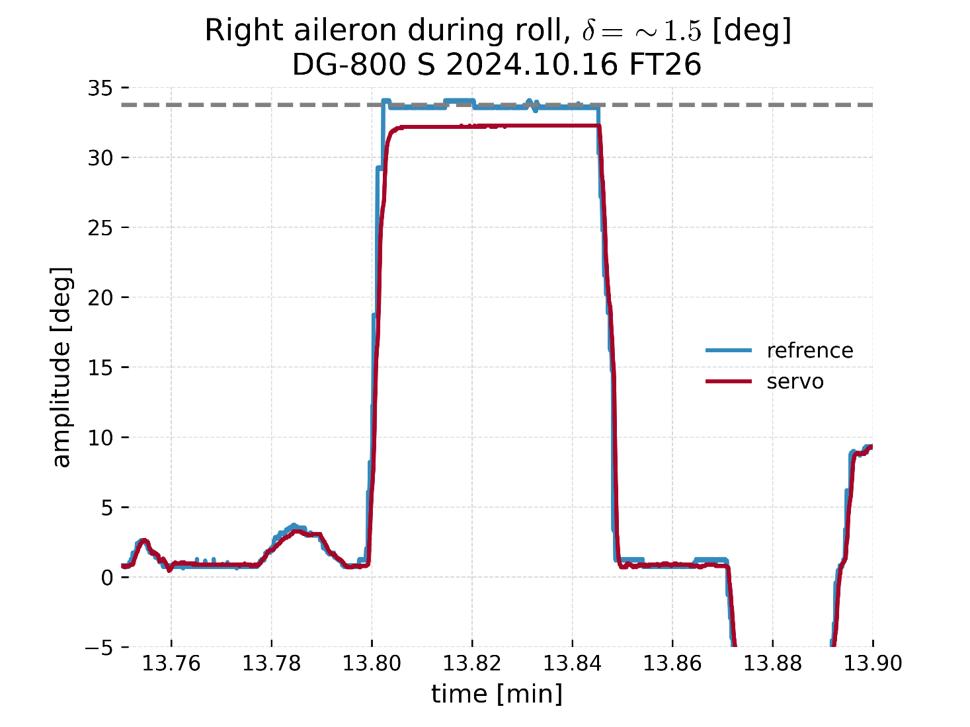
Notes:
Left aileron: measurement calibration and due to assymetric phisical limits of the servo movement.
Right aileron: well calbiratedb but due to to assymetric linkage configuration, higher hingle load is experienced.

Slide 16
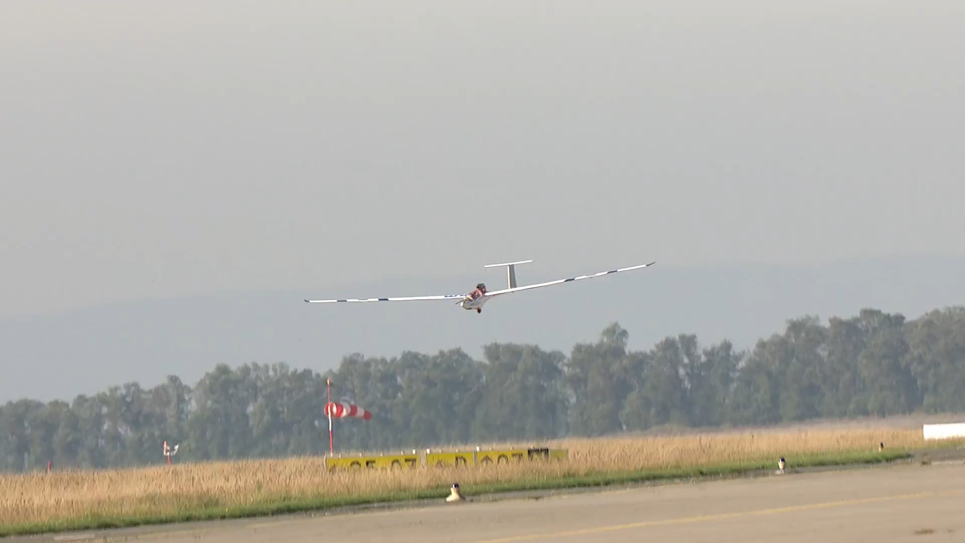

Slide 17
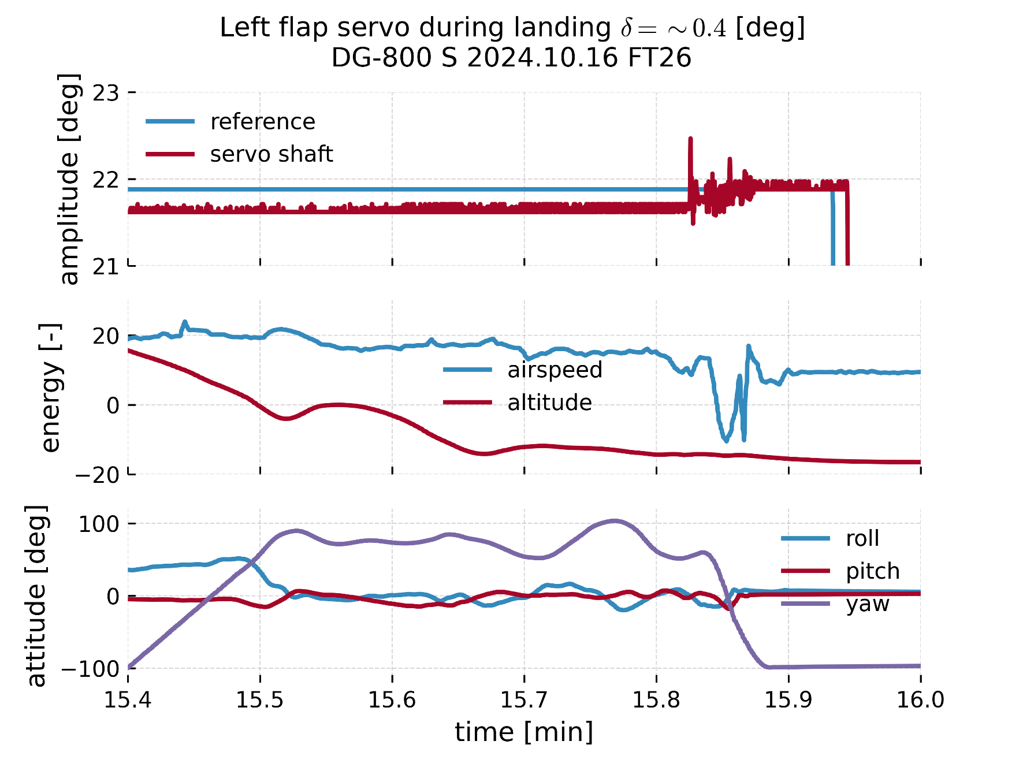

Slide 18
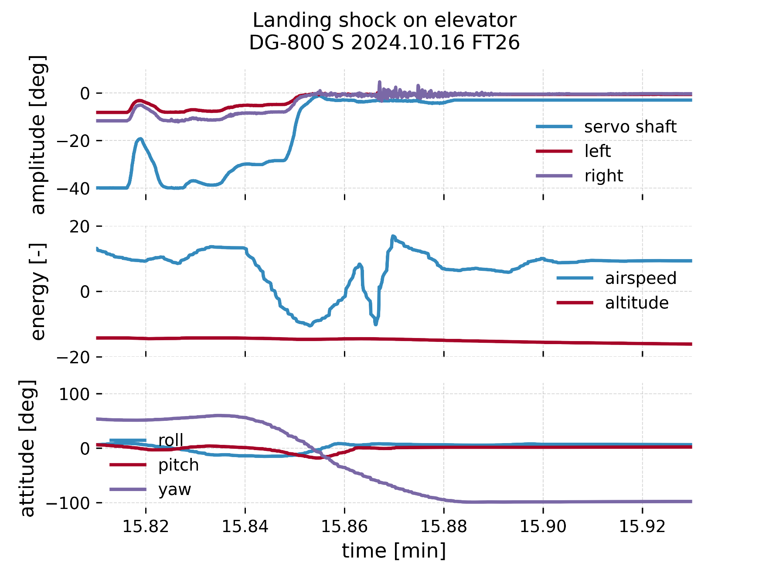

Slide 19
System layout
Flight segments
Takeaways

Slide 20
Takeaways – actuator monitoring system
Retrofitting sensitive systems with small parts needs a care and good design
A scalable and reusable solution is not always the best choice
Servo and control surface deflections are not what you think – unless you measure
Magnets do not like heat

Slide 21
Takeaways – flight testing
Fast feedback with high data rate and adjustable visualization
Continuous learning and adaptation
Maintain a proper flight diary
Maintain a small gap between a flight and it’s data analysis effort
Automatization in data processing and analysis

Slide 23
Sources
Picture of the DG-800 S: 5-th UAV Flight Test Convention, courtesy from DLR.
Flight videos: 5-th UAV Flight Test Convention, courtesy from DLR.
Flight data: TUM, LLS

Slide 24

This document and all information contained herein is the sole property of the Institute of Aircraft Design, Technische Universitaet Muenchen. No intellectual property rights are granted by the delivery of this document or the disclosure of its content. This document shall not be reproduced or disclosed to a third party without the expressed written consent of the Institute of Aircraft Design, Technische Universitaet Muenchen. This document and its content shall not be used for any purpose other than that for which it is supplied.
The statements made herein do not constitute an offer. They are based on the mentioned assumptions and are expressed in good faith. Where the supporting grounds for these statements are not shown, the Institute of Aircraft Design, Technische Universitaet Muenchen will be pleased to explain the basis thereof.
Dieses Dokument und alle darin enthaltenen Informationen sind das alleinige Eigentum des Lehrstuhls für Luftfahrtsysteme der Technischen Universität München. Die Zustellung dieses Dokumentes oder die Offenlegung seines Inhalts begründen keine Rechte am geistigen Eigentum. Dieses Dokument darf ohne die ausdrückliche schriftliche Genehmigung des Lehrstuhls für Luftfahrtsysteme der Technischen Universität München nicht vervielfältigt oder einem Dritten gegenüber enthüllt werden. Dieses Dokument und sein Inhalt dürfen nur zu bestimmungsgemäßen Zwecken verwendet werden.
Die in diesem Dokument gemachten Aussagen stellen kein Angebot dar. Sie wurden auf der Grundlage der auf-geführten Annahmen und in gutem Glauben gemacht. Wenn die zugehörigen Begründungen für diese Aussagen nicht angegeben sind, ist der Lehrstuhl für Luftfahrtsysteme gern bereit, deren Grundlage zu erläutern.
TECHNISCHE
UNIVERSITÄT
MÜNCHEN
Lehrstuhl für Luftfahrtsysteme

